Slide 1
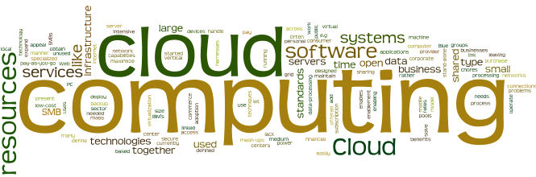
Cloud Compute Services

Slide 2


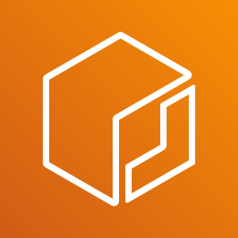



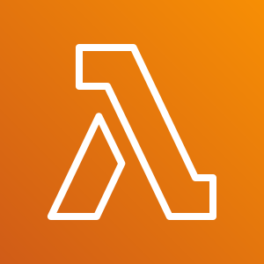
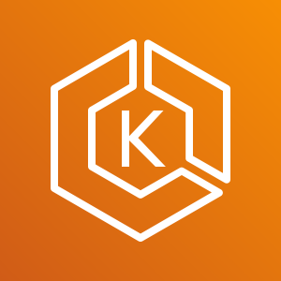

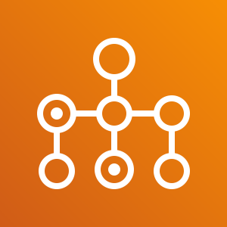
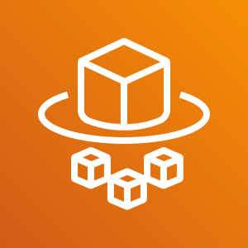

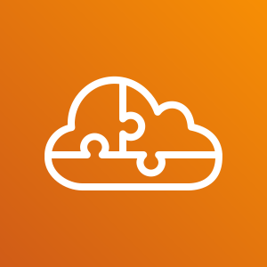
AWS Compute Services
Amazon EC2
Amazon EC2 Auto Scaling
Amazon Elastic Container Registry (Amazon ECR)
Amazon Elastic Container Service (Amazon ECS)
VMware Cloud on AWS
AWS Elastic Beanstalk
AWS Lambda
Amazon Elastic Kubernetes Service (Amazon EKS)
Amazon Lightsail
AWS Batch
AWS Fargate
AWS Outposts
AWS Serverless Application Repository
Notes:
Amazon Web Services (AWS) offers many compute services. Here is a brief summary of what each compute service offers:
Amazon Elastic Compute Cloud (Amazon EC2) provides resizable virtual machines.
Amazon EC2 Auto Scaling supports application availability by allowing you to define conditions that will automatically launch or terminate EC2 instances.
Amazon Elastic Container Registry (Amazon ECR) is used to store and retrieve Docker images.
Amazon Elastic Container Service (Amazon ECS) is a container orchestration service that supports Docker.
VMware Cloud on AWS enables you to provision a hybrid cloud without custom hardware.
AWS Elastic Beanstalk provides a simple way to run and manage web applications.
AWS Lambda is a serverless compute solution. You pay only for the compute time that you use.
Amazon Elastic Kubernetes Service (Amazon EKS) enables you to run managed Kubernetes on AWS.
Amazon Lightsail provides a simple-to-use service for building an application or website.
AWS Batch provides a tool for running batch jobs at any scale.
AWS Fargate provides a way to run containers that reduce the need for you to manage servers or clusters.
AWS Outposts provides a way to run select AWS services in your on-premises data center.
AWS Serverless Application Repository provides a way to discover, deploy, and publish serverless applications.
This module will discuss details of the services that are highlighted on the slide.

Slide 3
What is Container ?
Google says :
Containers are lightweight packages of your application code together with dependencies such as specific versions of programming language runtimes and libraries required to run your software services.
Docker says :
A container is a standard unit of software that packages up code and all its dependencies so the application runs quickly and reliably from one computing environment to another. A Docker container image is a lightweight, standalone, executable package of software that includes everything needed to run an application: code, runtime, system tools, system libraries and settings.

Slide 4
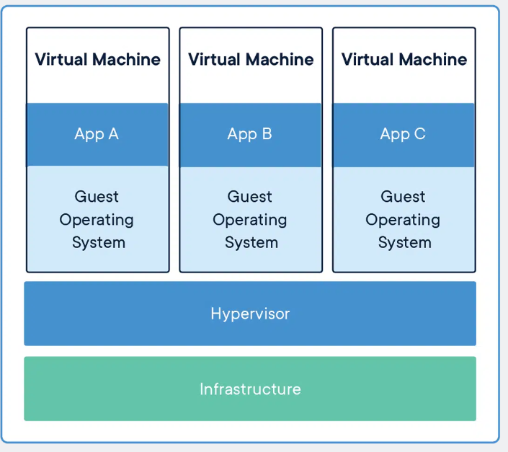
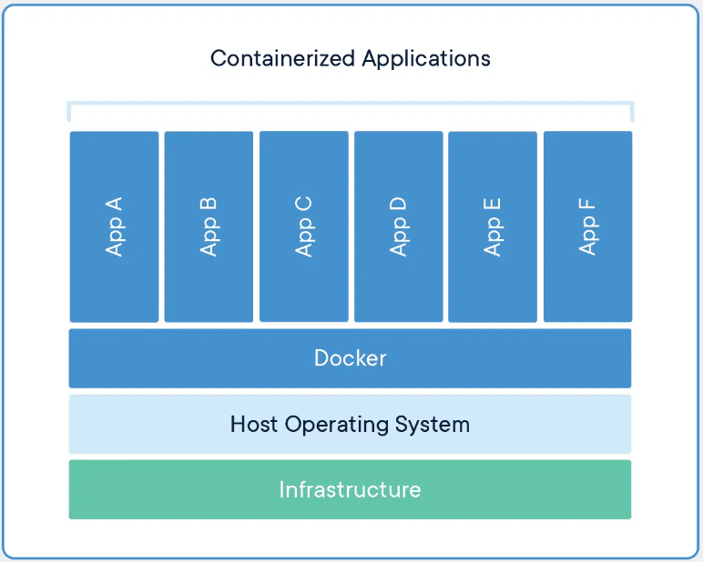
What is Container ?
Containers are an abstraction at the app layer that packages code and dependencies together.
Multiple containers can run on the same machine and share the OS kernel with other containers
Each containers isolated in their user space.
Containers take up less space than VMs
Can handle more applications and require fewer VMs and Operating systems.
Virtual machines (VMs) are an abstraction of hardware
The hypervisor allows multiple VMs to run on a single machine.
Each VM includes a full copy of an operating system, the application, necessary binaries and libraries
VMs can also be slow to boot.
Notes:
CONTAINERS
Containers are an abstraction at the app layer that packages code and dependencies together. Multiple containers can run on the same machine and share the OS kernel with other containers, each running as isolated processes in user space. Containers take up less space than VMs (container images are typically tens of MBs in size), can handle more applications and require fewer VMs and Operating systems.
VIRTUAL MACHINES
Virtual machines (VMs) are an abstraction of physical hardware turning one server into many servers. The hypervisor allows multiple VMs to run on a single machine. Each VM includes a full copy of an operating system, the application, necessary binaries and libraries – taking up tens of GBs. VMs can also be slow to boot.

Slide 5
Containers
Containers are primarily presented as the next-generation application delivery platform.
Containers are bringing mechanism for efficiently virtualizing the OS for the sole purpose of running applications on a single kernel host.
Containerization creates abstraction at an OS level that allows individual, modular and distinct functionality of the app to run independently.

Slide 6
Containers
Containerization is increasingly popular because containers are:
Flexible: Even the most complex applications can be containerized.
Lightweight: Containers leverage and share the host kernel.
Interchangeable: You can deploy updates and upgrades on-the-fly.
Portable: You can build locally, deploy to the cloud, and run anywhere.
Scalable: You can increase and automatically distribute container replicas.
Stackable: You can stack services vertically and on-the-fly.

Slide 7
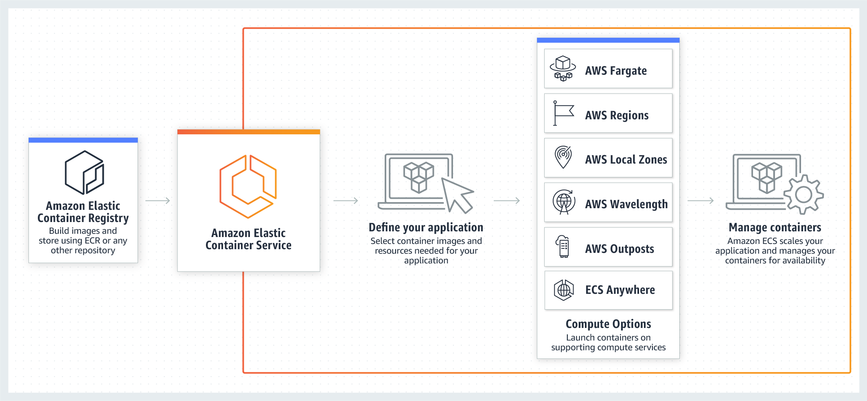
AWS Elastic Container Services ( Amazon ECS)
Amazon ECS is a fully managed container orchestration service that helps you easily deploy, manage, and scale containerized applications.
It deeply integrates with the rest of the AWS platform to provide a secure and easy-to-use solution for running container workloads in the cloud and now on your infrastructure with Amazon ECS Anywhere.
Notes:
AWS Systems Manager Agent (SSM Agent) is Amazon software that runs on Amazon Elastic Compute Cloud (Amazon EC2) instances, edge devices, and on-premises servers and virtual machines (VMs). SSM Agent makes it possible for Systems Manager to update, manage, and configure these resources. The agent processes requests from the Systems Manager service in the AWS Cloud, and then runs them as specified in the request. SSM Agent then sends status and execution information back to the Systems Manager service by using the Amazon Message Delivery Service

Slide 8
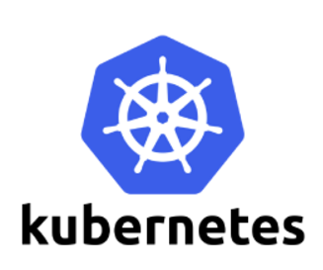
Kubernetes
Kubernetes is a cluster and container management tool, open-sourced by Google in 2014.
It provides a “platform for automating deployment, scaling, and operations of application containers across clusters of hosts” , this lowers the cost of cloud computing expenses and simplifies operations and architecture.
Kubernetes provides you with:
Service discovery and load balancing
Storage orchestration
Automated rollouts and rollbacks
Automatic bin packing
Self-healing
Configuration management

Slide 9
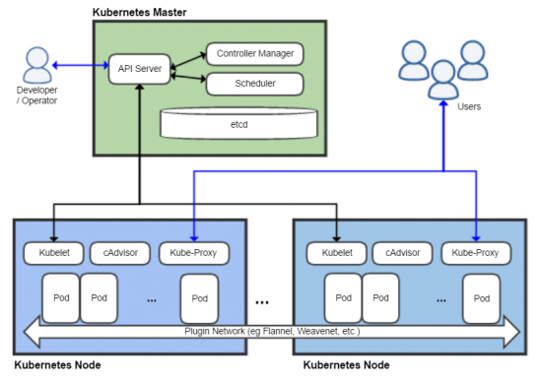
Kubernetes
The cluster’s main function is called the control plane, and it runs all the tasks required for Kubernetes to do its job: scheduling containers, managing Services, serving API requests
Master Node/Control Plane:
Node controller is responsible for initializing a node by obtaining information about the nodes running in the cluster from the cloud provider.
Route controller is responsible for configuring routes in the cloud appropriately so that containers on different nodes in the Kubernetes cluster can communicate with each other.
Service controller is responsible for listening to service create, update, and delete events.
Control Plane
The kubelet is the primary “node agent” that runs on each node.
A Kubernetes Node is a logical collection of IT resources that supports one or more containers.
Nodes contain the necessary services to run Pods (which are Kubernetes's units of containers), communicate with master components, configure networking and run assigned workloads

Slide 10
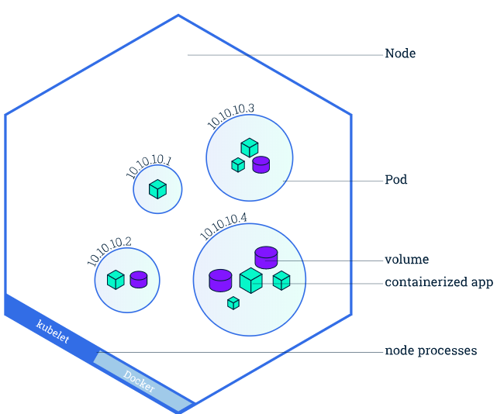
Kubernetes
A Pod always runs on a Node.
A Node is a worker machine in Kubernetes and may be either a virtual or a physical machine, depending on the cluster.
Each Node is managed by the Master.
A Node can have multiple pods, and the Kubernetes master automatically handles scheduling the pods across the Nodes in the cluster.
The Master's automatic scheduling takes into account the available resources on each Node.
Kubelet, a process responsible for communication between the Kubernetes Master and the Node; it manages the Pods and the containers running on a machine.
A container runtime (Docker) responsible for pulling the container image from a registry, unpacking the container, and running the application.

Slide 11
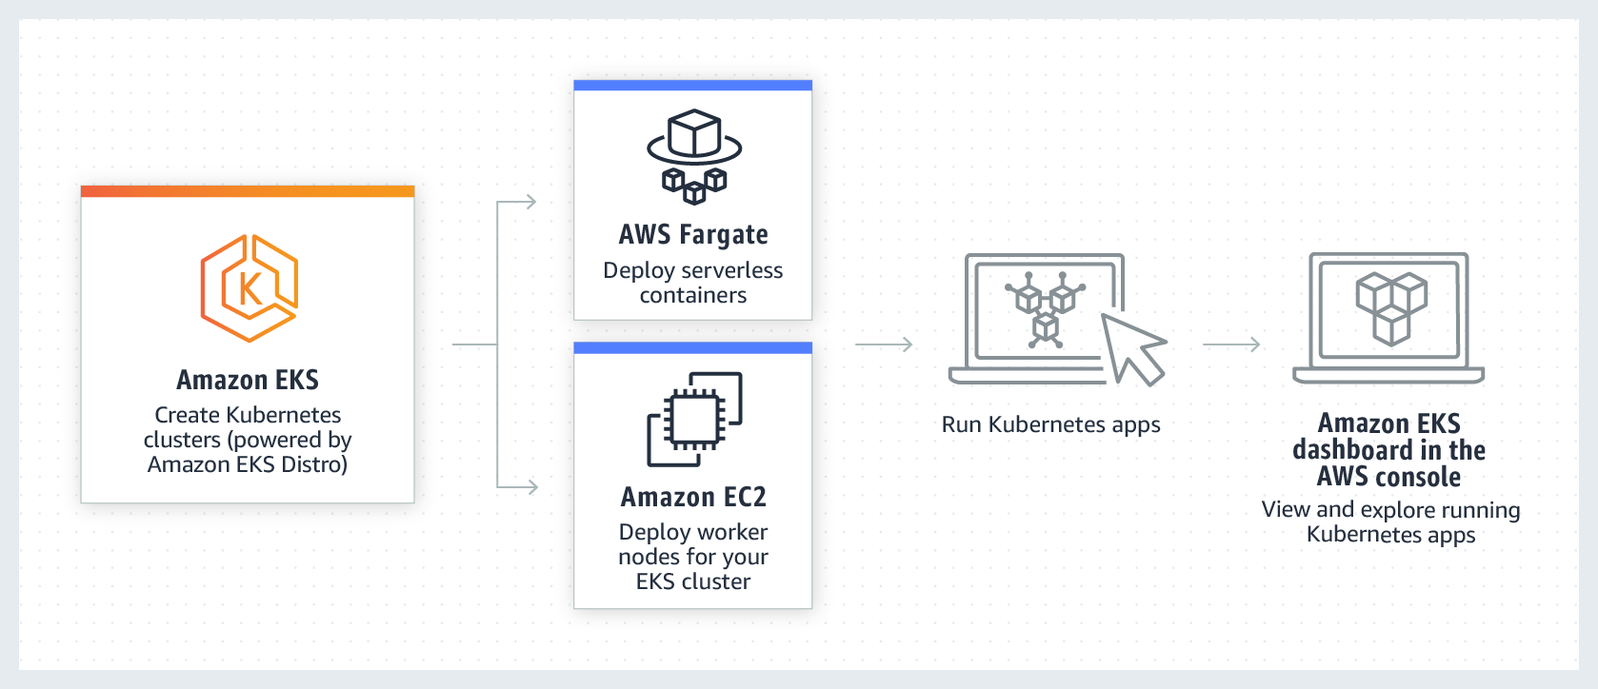
AWS Elastic Kubernets Services ( Amazon ECS)
Amazon Elastic Kubernetes Service (Amazon EKS) is a managed container service to run and scale Kubernetes applications in the cloud or on-premises.
Deploy applications with Amazon EKS in the cloud Deploy applications with Amazon EKS Anywhere Deploy applications with your own tools

Slide 12
What is Serverless means in Cloud ?
Serverless is a cloud-native development model that allows developers to build and run applications without having to manage servers. There are still servers in serverless, but they are abstracted away from app development
Serverless technologies feature in AWS ;
automatic scaling,
built-in high availability, and
a pay-for-use billing model to increase agility and optimize costs.
These technologies also eliminate infrastructure management tasks like capacity provisioning and patching, so you can focus on writing code that serves your customers.
Serverless applications start with AWS Lambda

Slide 13

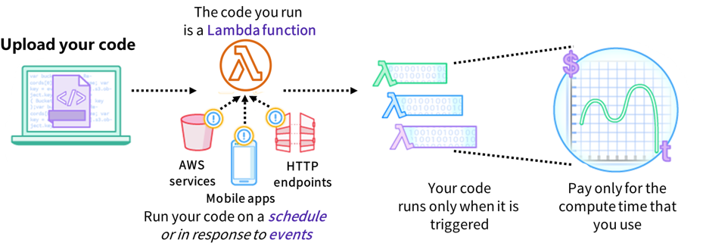
AWS Lambda
AWS Lambda is a serverless, event-driven compute service that lets you run code for virtually any type of application or backend service without provisioning or managing servers.
It supports multiple programming languages (Java, Go, PowerShell, Node. js, C#, Python, and Ruby code)
Completely automated administration
Built-in fault tolerance
It supports the orchestration of multiple functions

Slide 14
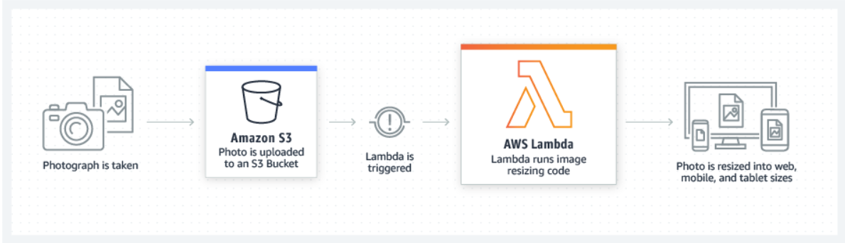
AWS Lambda use cases : File Processing

Slide 15
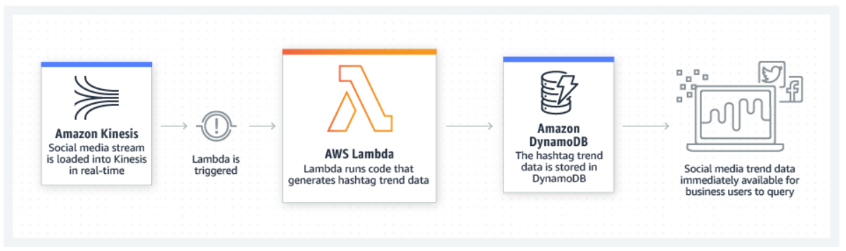
AWS Lambda use cases : Streaming Processing
Notes:
Use AWS Lambda and Amazon Kinesis to process real-time streaming data for application activity tracking, transaction order processing, clickstream analysis, data cleansing, log filtering, indexing, social media analysis, IoT device data telemetry, and metering

Slide 16
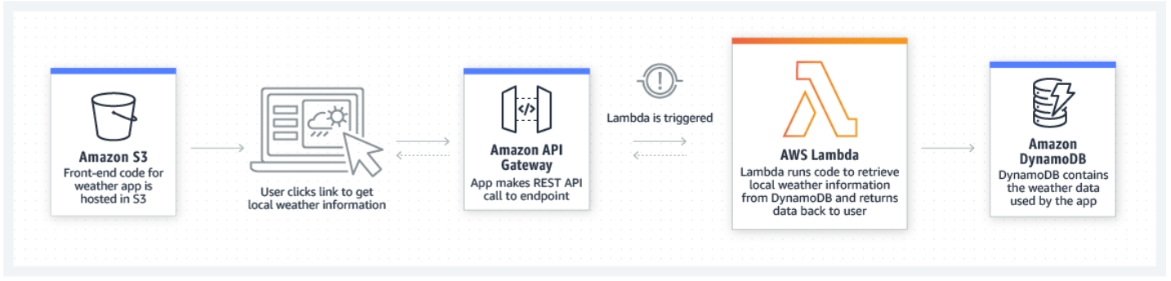
AWS Lambda use cases: Web application
Notes:
Combine AWS Lambda with other AWS services to build powerful web applications that automatically scale up and down and run in a highly available configuration across multiple data centers.

Slide 17
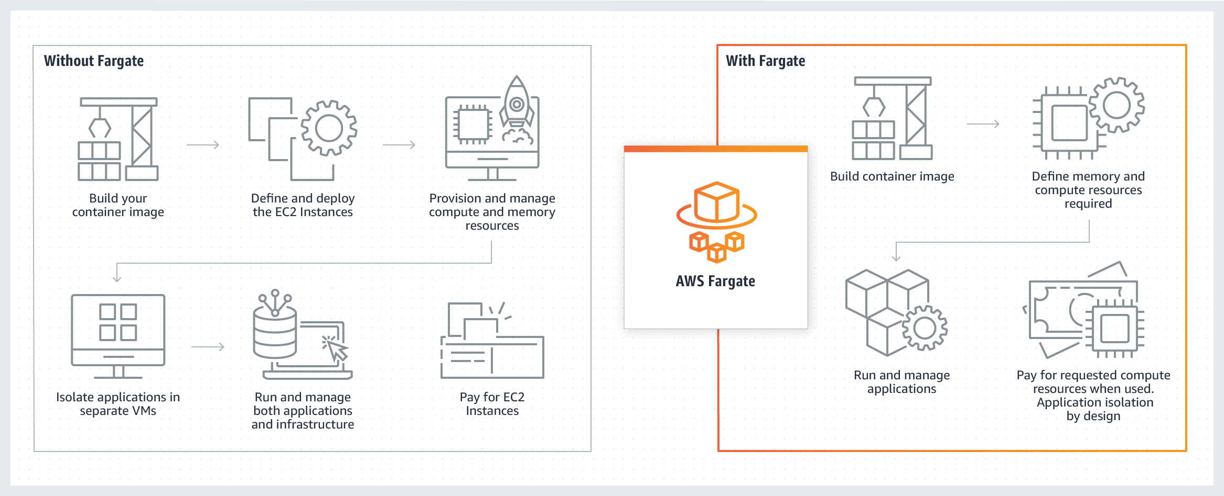
AWS Fargate
AWS Fargate is a serverless, pay-as-you-go compute engine that lets you focus on building applications without managing servers.
AWS Fargate is compatible with both Amazon Elastic Container Service (ECS) and Amazon Elastic Kubernetes Service (EKS).
Fargate eliminates the need to provision and manage servers, lets you specify and pay for resources per application, and improves security through application isolation by design.

Slide 18
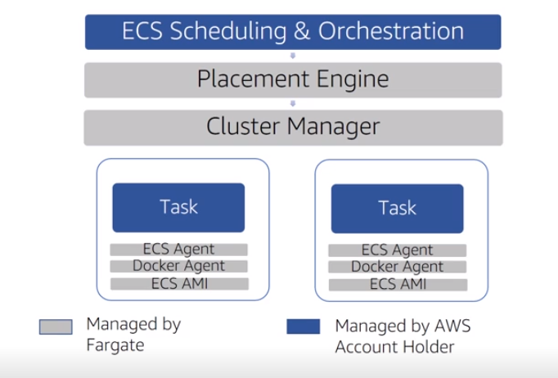
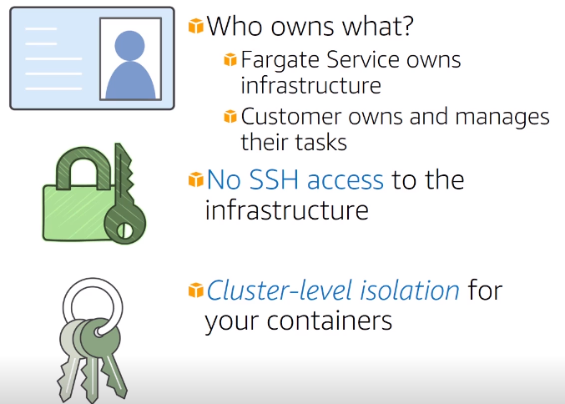
AWS Fargate
Define your tasks and focus on your code
Use cases

Slide 19
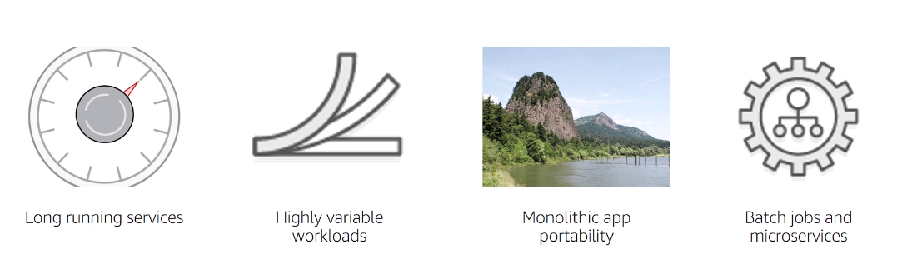
AWS Fargate Use Cases

Slide 20
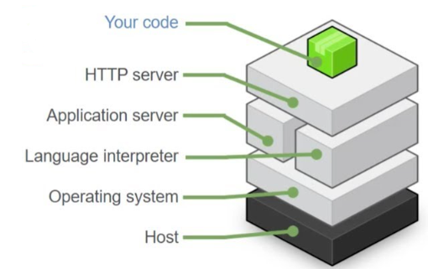
AWS Elastic Beanstalk
An easy way to get web applications up and running
A managed service that automatically handles
Infrastructure provisioning and configuration
Deployment
Load balancing
Automatic scaling
Health monitoring
Analysis and debugging
Logging
No additional charge for Elastic Beanstalk
Pay only for the underlying resources that are used
Elastic Beanstalk supports applications developed in Go, Java, .NET, Node.js, PHP, Python, and Ruby

Slide 21
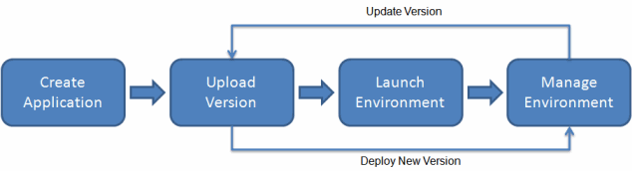
AWS Elastic Beanstalk
Notes:
To use Elastic Beanstalk, you create an application, upload an application version in the form of an application source bundle (for example, a Java .war file) to Elastic Beanstalk, and then provide some information about the application. Elastic Beanstalk automatically launches an environment and creates and configures the AWS resources needed to run your code. After your environment is launched, you can then manage your environment and deploy new application versions. The following diagram illustrates the workflow of Elastic Beanstalk.

Slide 22
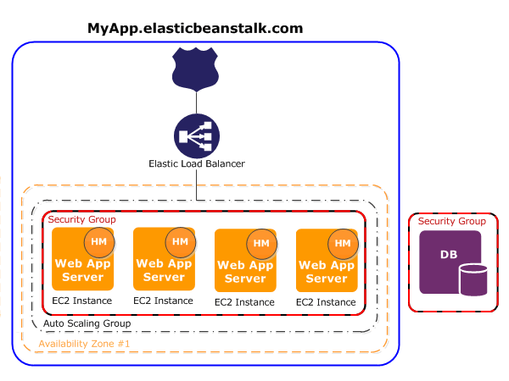
AWS Elastic Beanstalk
The software stack running on the Amazon EC2 instances is dependent on the container type. A container type defines the infrastructure topology and software stack to be used for that environment.
Each Amazon EC2 instance that runs your application uses one of these container types. In addition, a software component called the host manager (HM) runs on each Amazon EC2 instance. The host manager is responsible for the following:
Deploying the application
Aggregating events and metrics for retrieval via the console, the API, or the command line
Generating instance-level events
Monitoring the application log files for critical errors
Monitoring the application server
Patching instance components
Rotating your application's log files and publishing them to Amazon S3
The host manager reports metrics, errors and events, and server instance status, which are available via the Elastic Beanstalk console, APIs, and CLIs.

Slide 23
Questions ?

